Slide 1
Real Estate Salespersons
Quick Renewal Tab Overview
By Deanna Daniels, Systems Analyst,
and Jorge Bannister, Implementation Aide

Slide 2
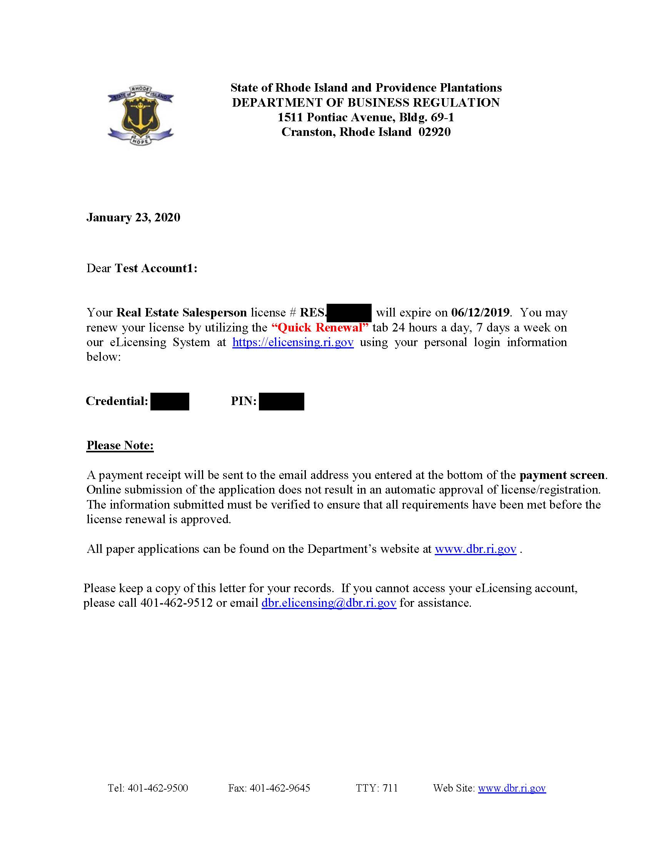
The Renewal Letter will look slightly different this time around and will include Credential and Pin

Slide 3
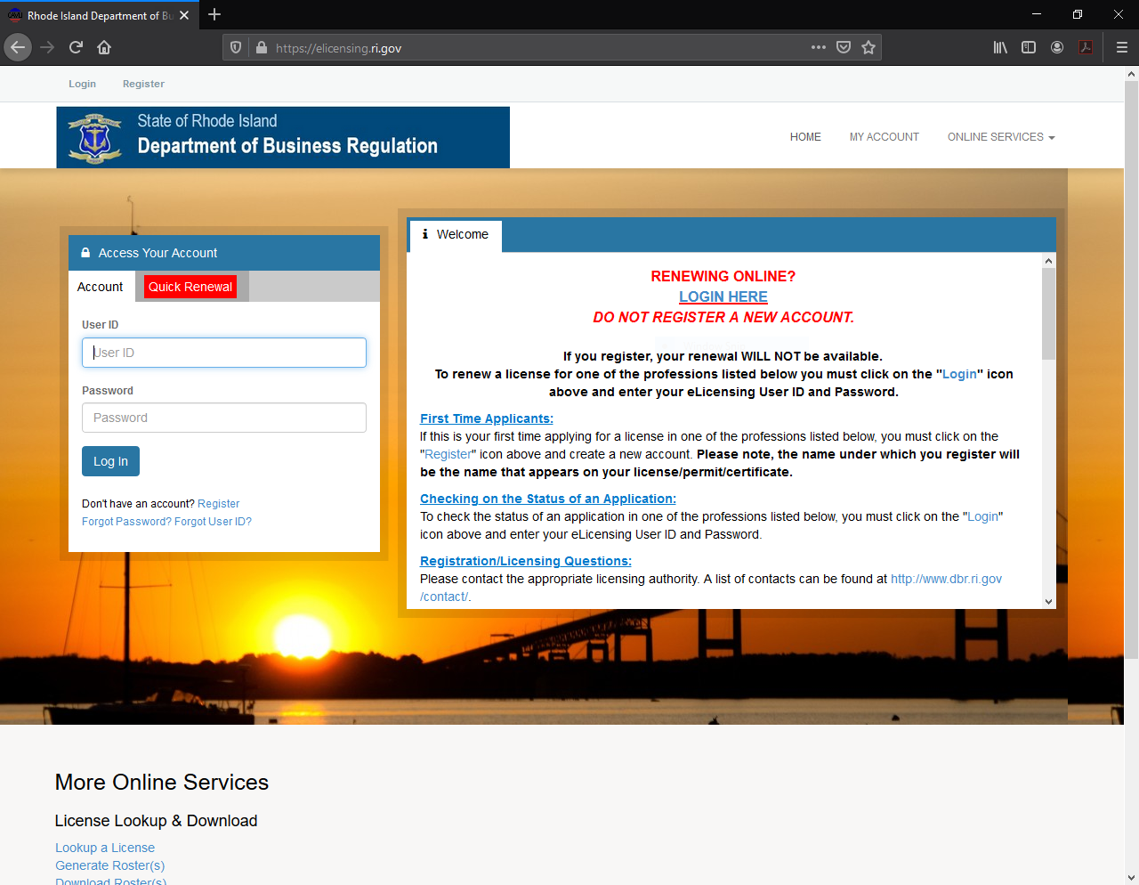
Much like in the past, you will go to elicensing.ri.gov to get started

Slide 4
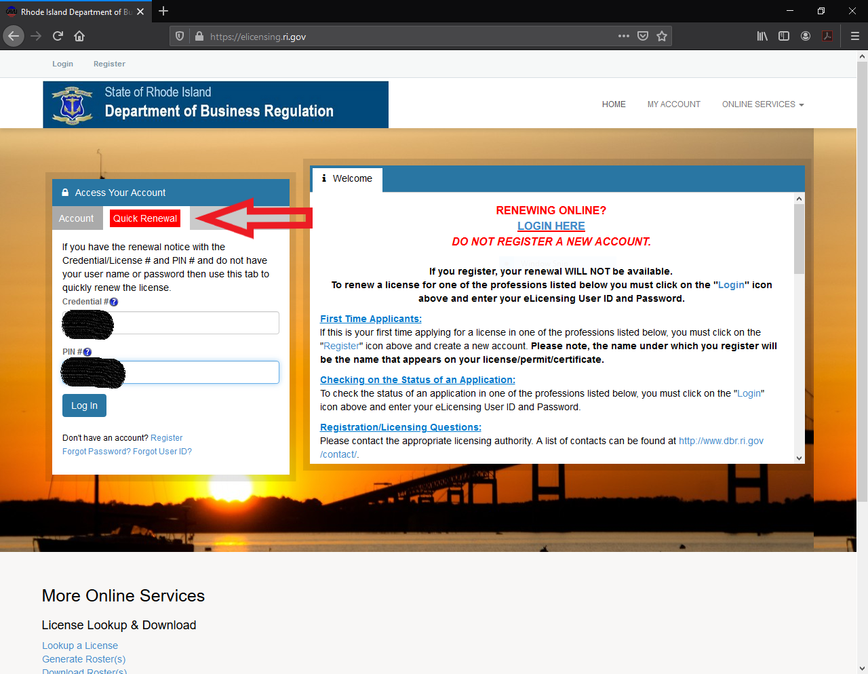
Make sure to select the Quick Renewal on the left, and insert your Credential Number and Pin

Slide 5
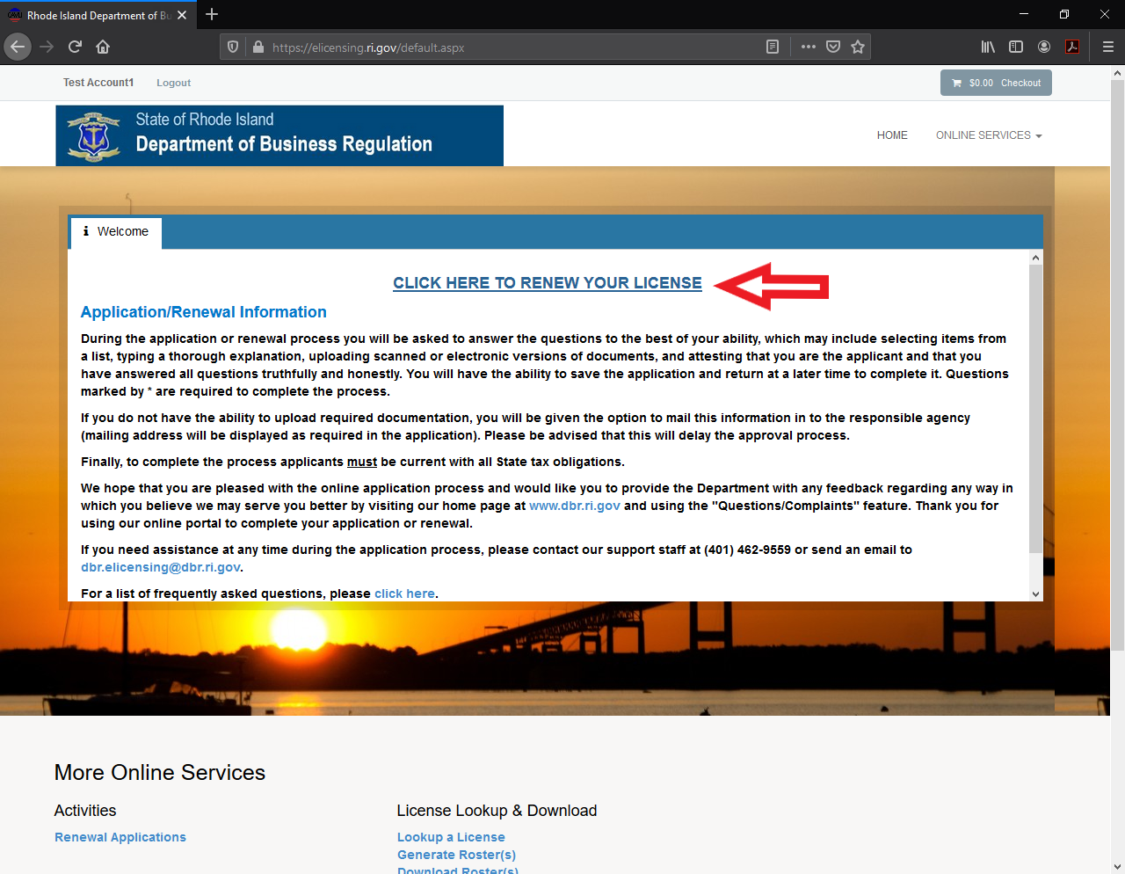
At the very top of the box, you will see the link to renew the license

Slide 6
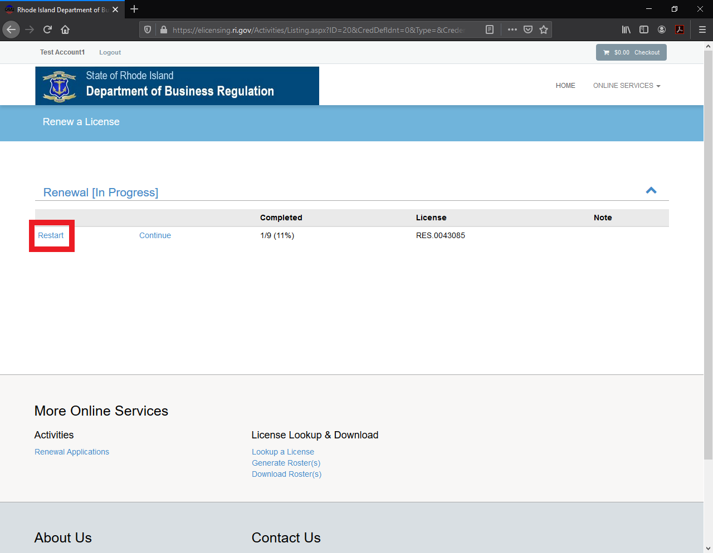
Click on the Start/Restart button on the left-hand side to begin the renewal process

Slide 7
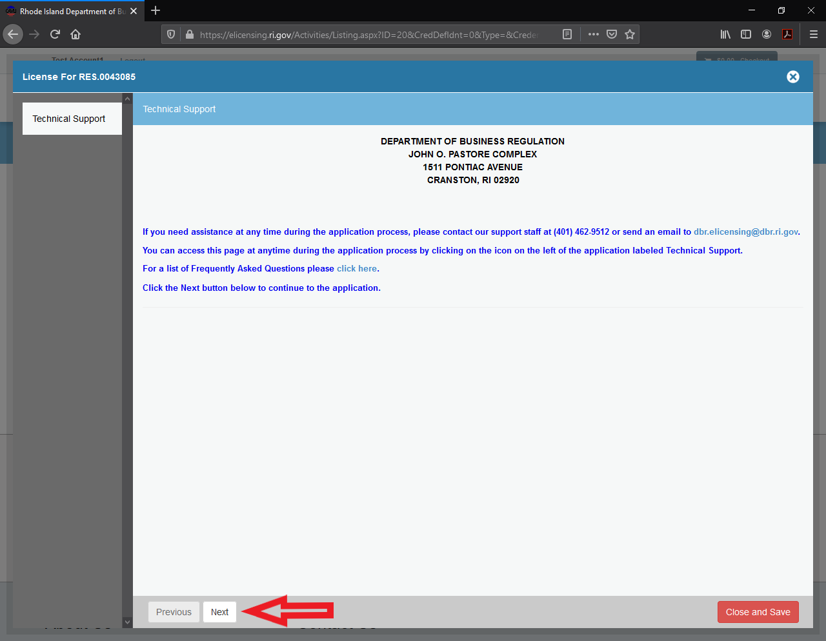
Should you get stuck, here’s contact information. Once you’re ready to begin, click “Next” in the lower left-hand corner

Slide 8
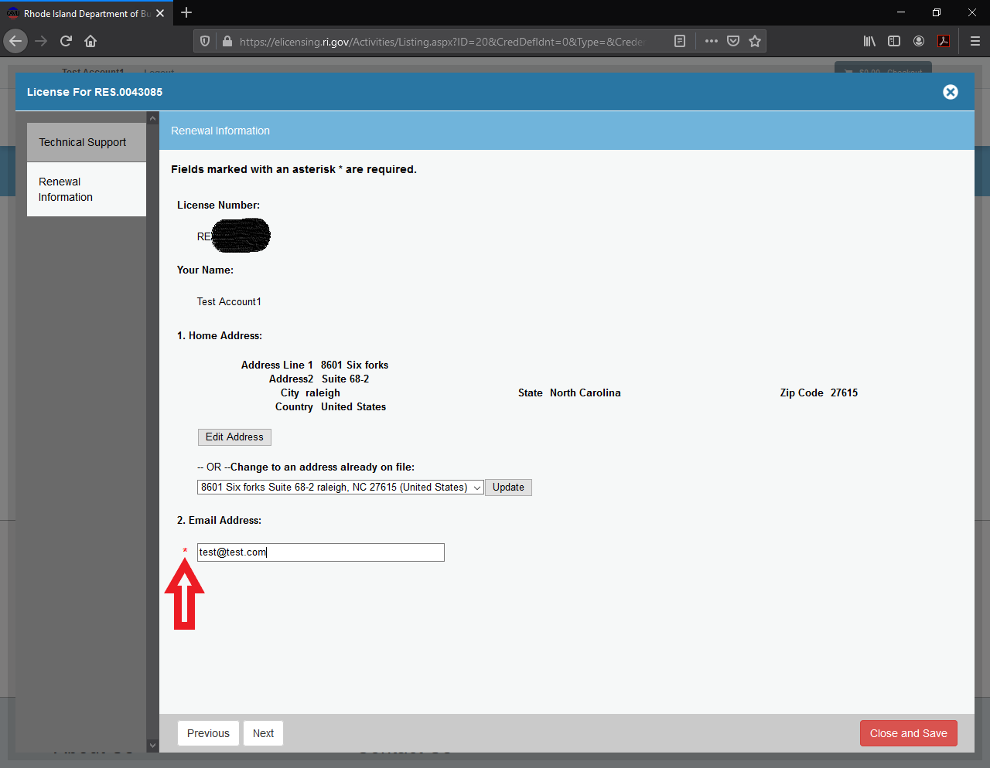
Anything with a red asterisk next to it is a mandatory field; information, or a selection, must be made before you’re able to continue

Slide 9
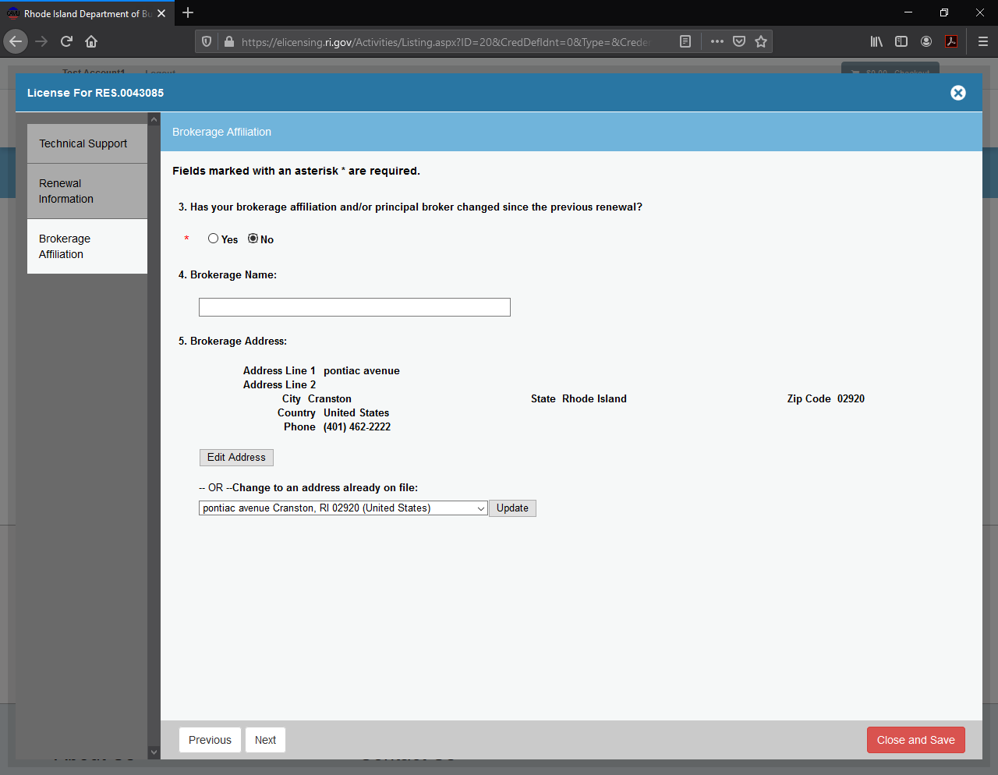
As you get to questions pertaining to your broker, if nothing has changed, GREAT! Select no, and then “Next” in the lower left-hand corner

Slide 10
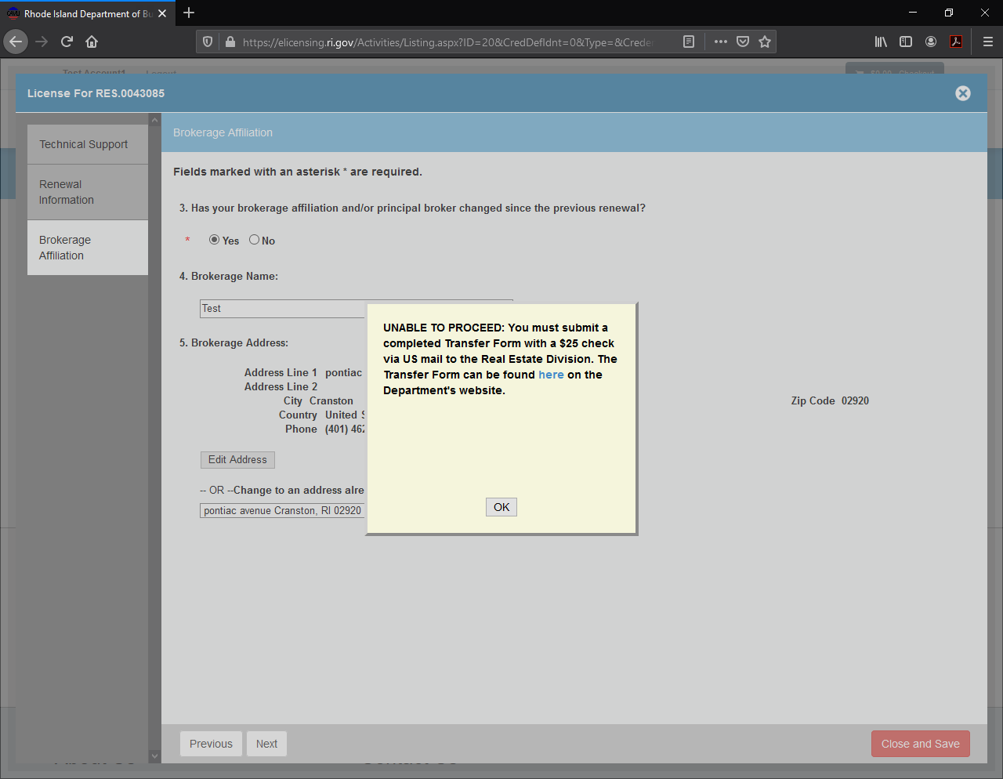
However, if you did change brokers since your last license, you will be forced to stop the application, and directed to fill out the appropriate form

Slide 11
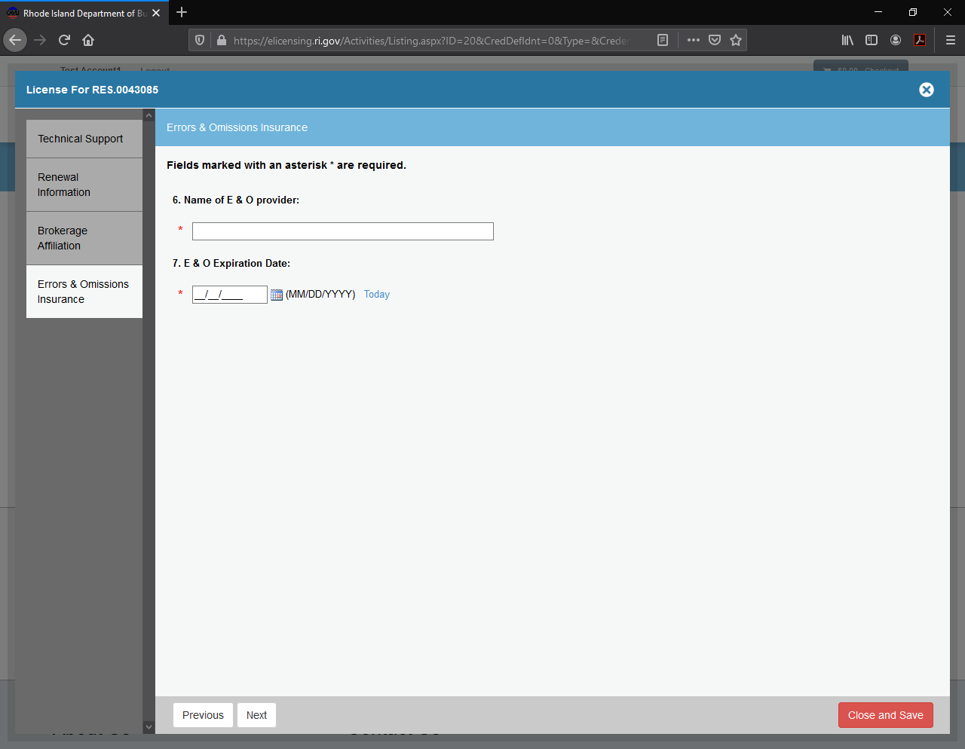
Provide your E&O Insurance provider and expiration date

Slide 12
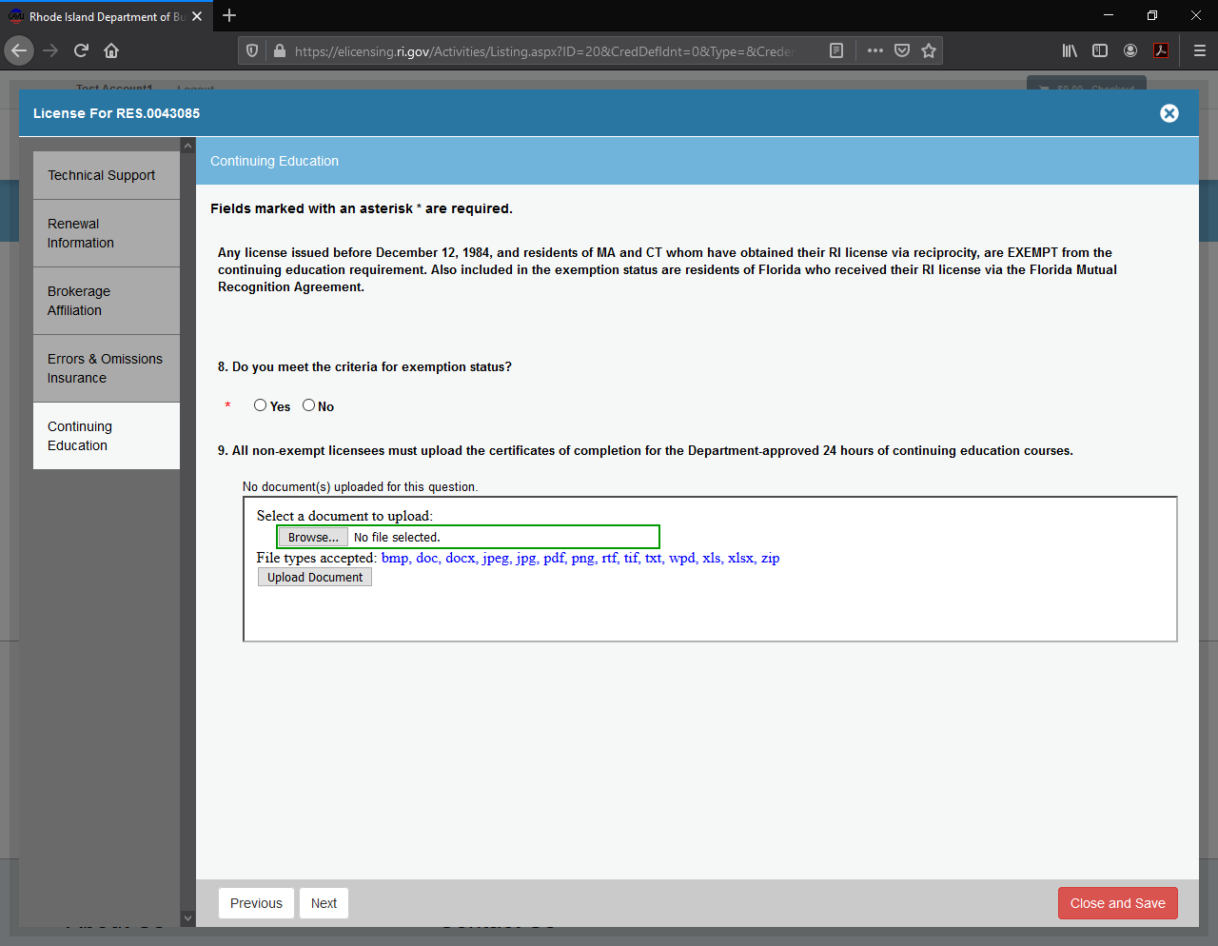
Continuing Education and Exemptions

Slide 13
Continuing Ed and Exemptions (Cont.)
If you meet the exemption requirements included in the help text toward the top of this section, SPLENDID! Click “Yes” and then “Next” in the lower left-hand corner.
However, if you do not meet the exemption requirements, you must upload proof of satisfactory completion of your CE courses. Once you upload the certificates, click “Next” in the lower left-hand corner to continue with the application.

Slide 14
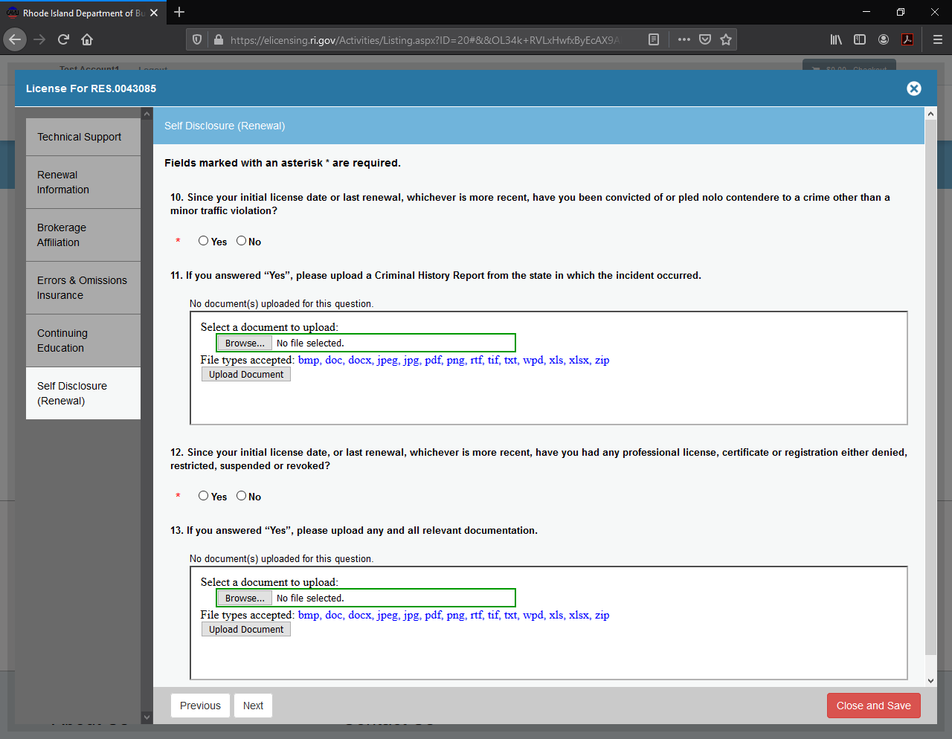
Criminal History and License Revocation

Slide 15
Criminal History and License Revocation (Cont.)
If you answer yes to being convicted or pleading nolo contendere to a crime other than a minor traffic violation, you must upload a copy of the Criminal History Report from the state in which the crime was committed.
If you answer yes to license revocation, you must upload any and all relevant documentation (i.e.; Order or Consent Agreement from the state which revoked, denied, or suspended your license).

Slide 16
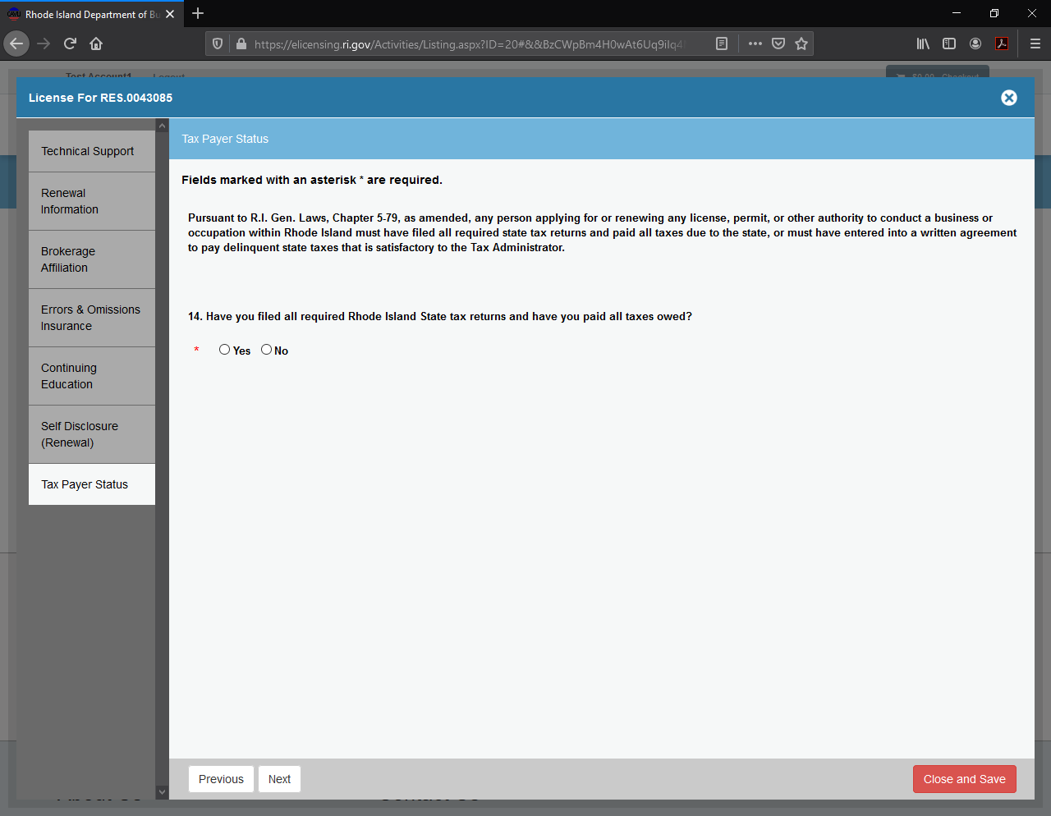
Tax Affidavit Status

Slide 17
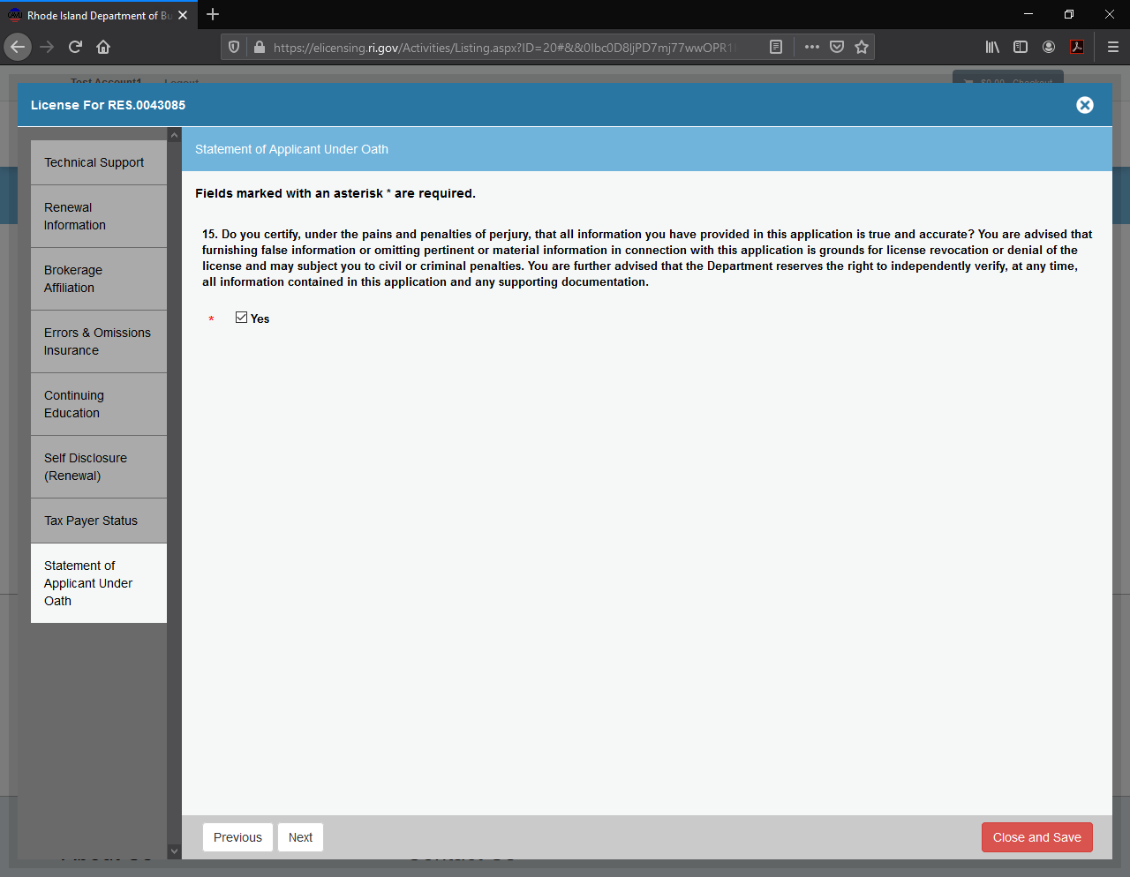
Applicant Certification/
Digital Signature

Slide 18
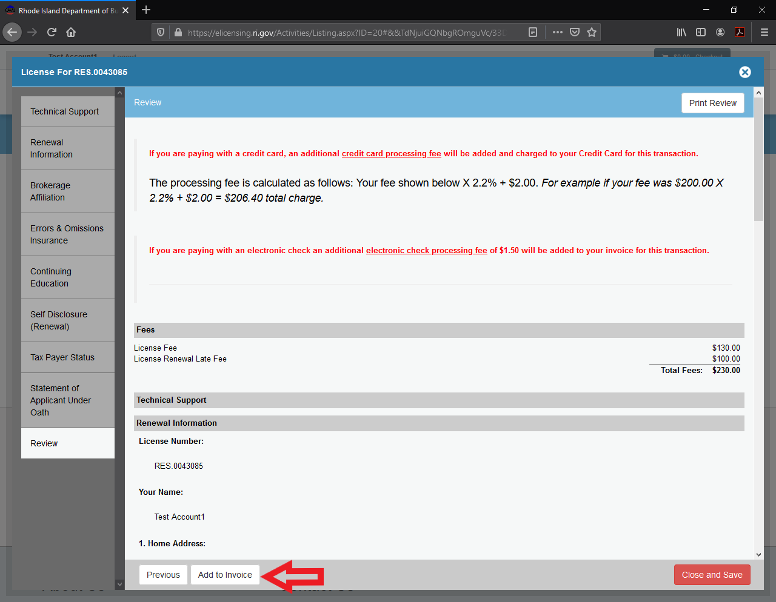
Almost Done …
Review the application, and, if everything is in order, click on “Add to Invoice” in the lower left-hand corner

Slide 19
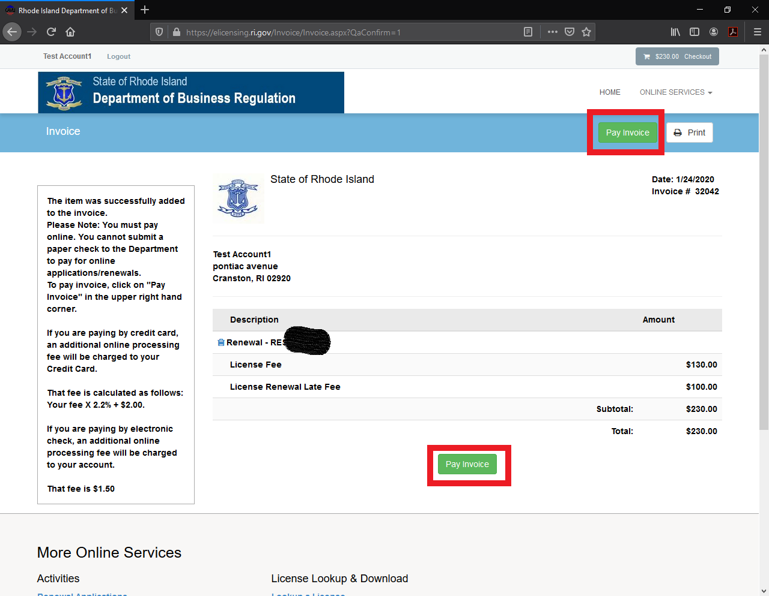
Pay your invoice, and your application is officially submitted!

